Slide 1
GCM 教學與說明
Author: Sonny Shih
Date: 2015/11/26

Slide 2
GCM 設定說明
https://developers.google.com/cloud-messaging/android/client
設定Google 專案 console
(Google Developers Console)
https://console.developers.google.com/

Slide 3
Overview
GCM
Google Cloud Messaging
Send messages between servers and client apps
Downstream messages from servers to client apps
a GCM message can transfer up to 4kb of payload to the client app
Upstream messages from client apps to servers.

Slide 4
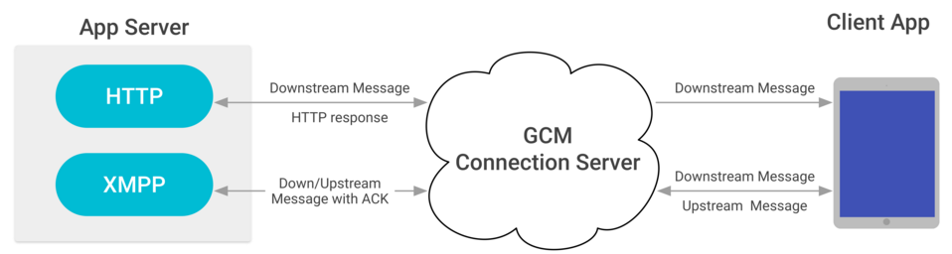
Overview
GCM Architecture
App Server
GCM connection Server
Client App
App must register with GCM and get a unique identifier called a registration token

Slide 5
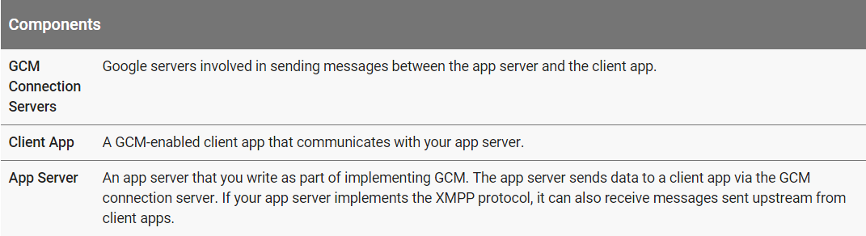
Overview
Components

Slide 6
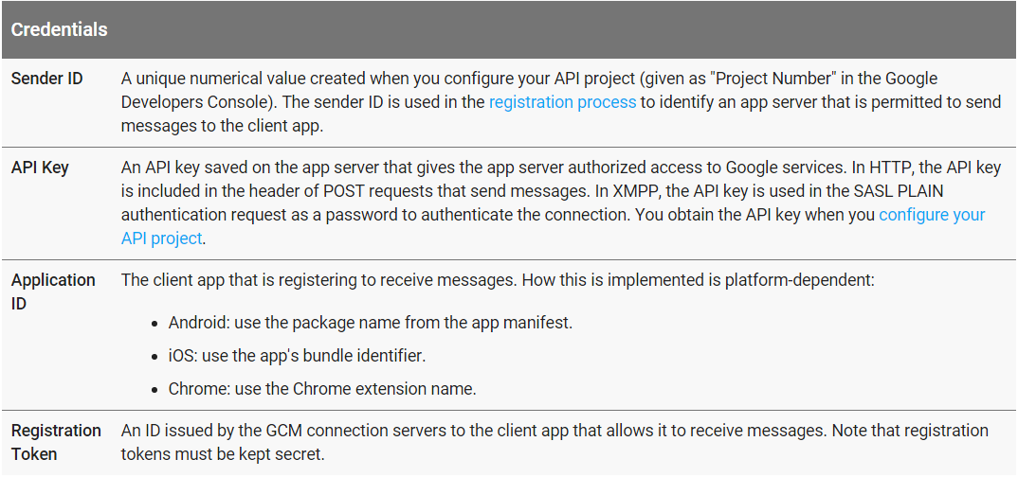
Overview
Credentials

Slide 7
Overview
Communication Type
Versatile Messaging Targets
Device group message
Topic message
Downstream Messaging
Send downstream messages
Upstream Messaging
Send upstream messages

Slide 8
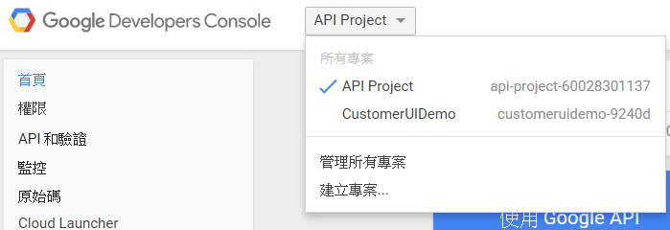
建立Google 新專案 (1/2)
進入Google Develop Console
https://console.developers.google.com/
建立專案

Slide 9
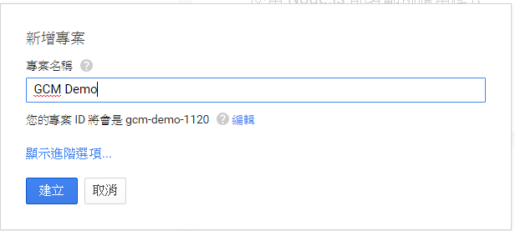
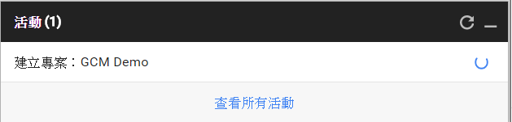
建立Google 新專案 (2/2)
輸入專案名稱，建立專案
建立專案

Slide 10
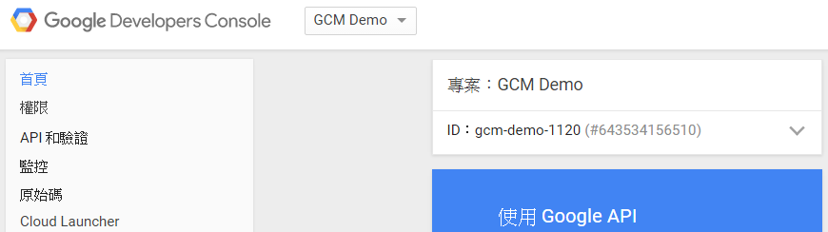
產生API金鑰 (API Key) (1/5)
進入新建立的專案

Slide 11
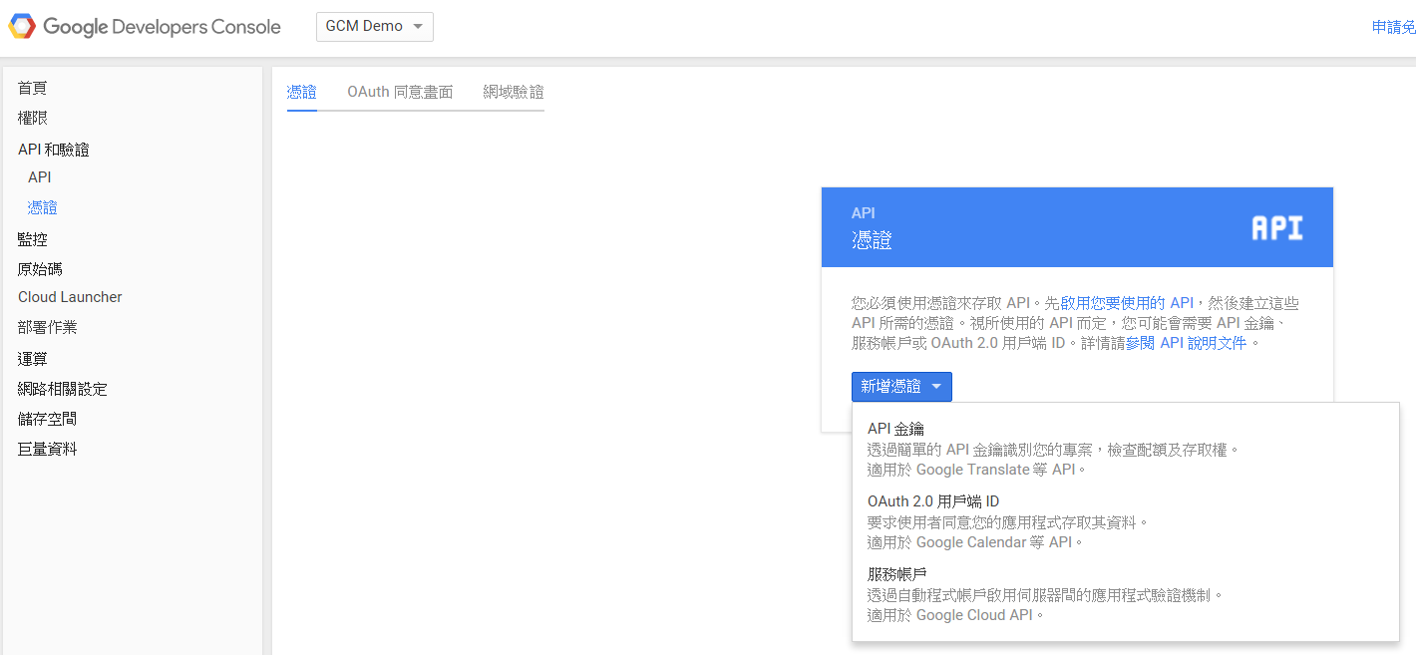
產生API金鑰 (API Key) (2/5)
建立API Key (API 金鑰)

Slide 12
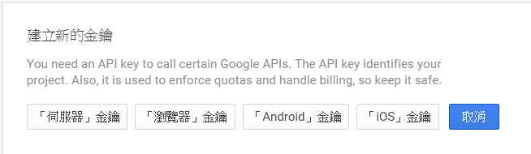
產生API金鑰 (API Key) (3/5)
選擇「伺服器金鑰」

Slide 13
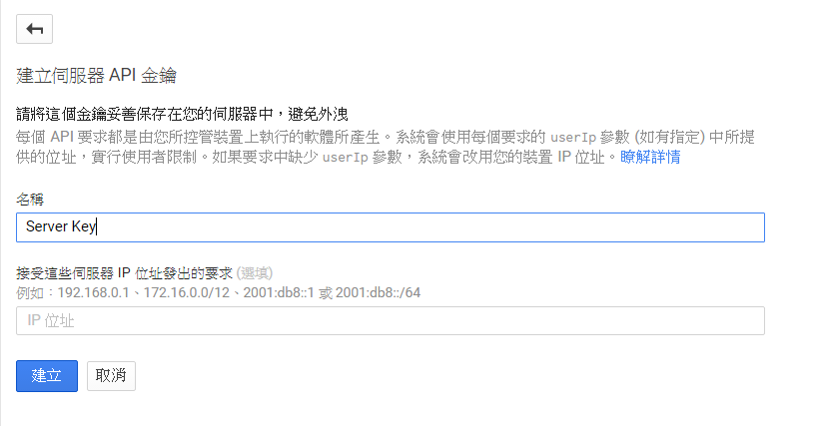
產生API金鑰 (API Key) (4/5)
填寫”名稱”，按下”建立”

Slide 14
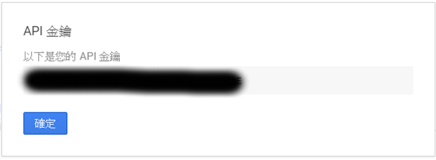
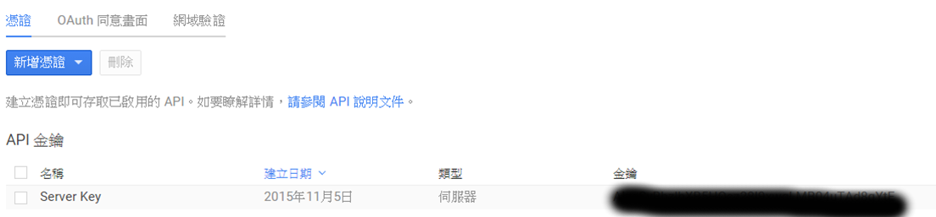
產生API金鑰 (API Key) (5/5)
得到API 金鑰

Slide 15
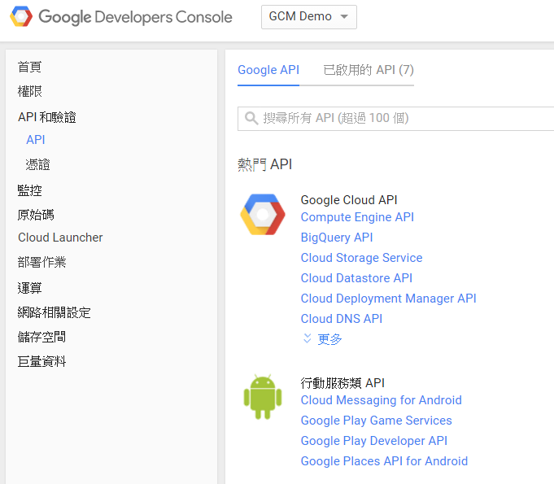
開啟Cloud Messaging 服務 (1/2)
進入 Cloud Messaging 服務

Slide 16
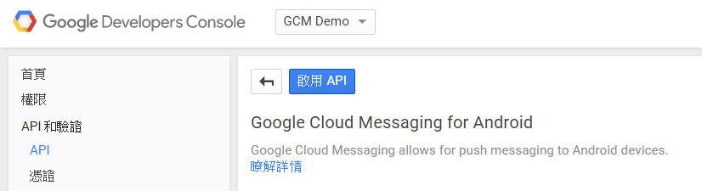
開啟Cloud Messaging 服務 (2/2)
開啟服務

Slide 17
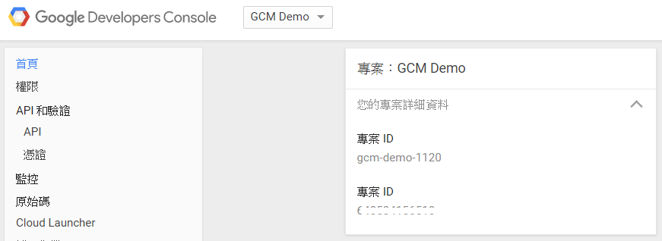
取得token (專案ID)
Token (專案ID)

Slide 18
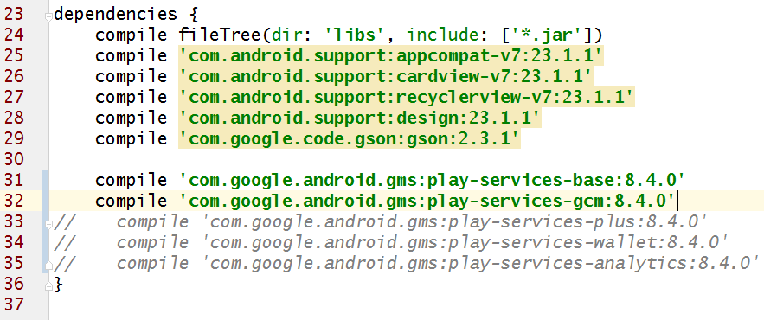
設定Application gradle 檔案 (1/2)
設定Application 的 build.gradle
增加dependencies
compile 'com.google.android.gms:play-services-base:8.4.0'
compile 'com.google.android.gms:play-services-gcm:8.4.0'
設定完成後，要Rebuild project，設定的值才會生效

Slide 19
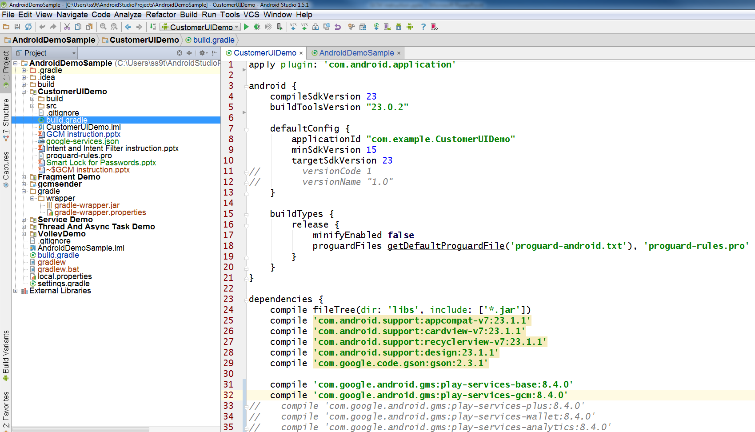
設定Application gradle 檔案 (2/2)
增加dependencies

Slide 20
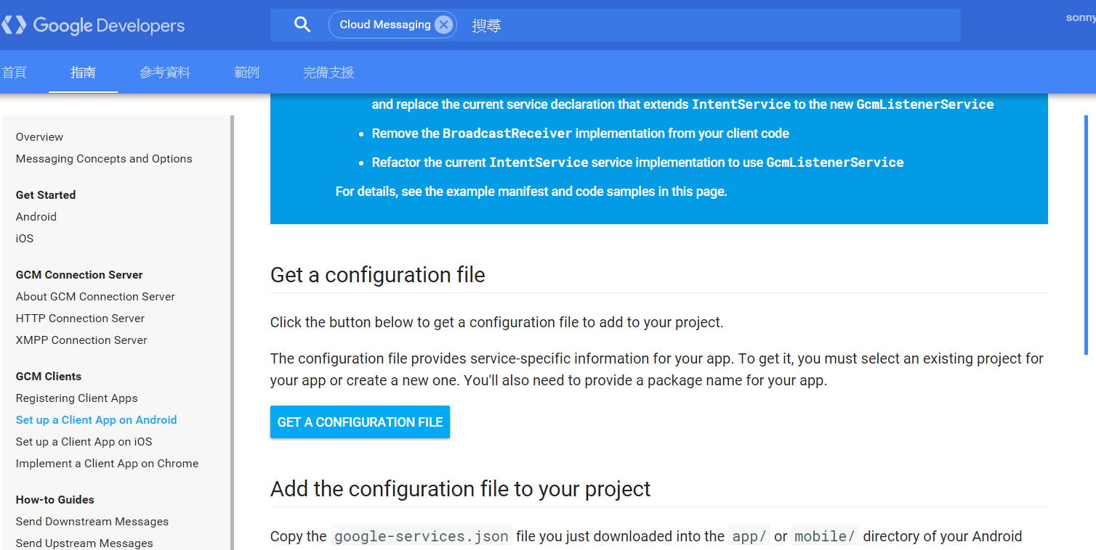
取得 google-services.json (1/6)
取得google-services.json網址
https://developers.google.com/cloud-messaging/android/client#get-config

Slide 21
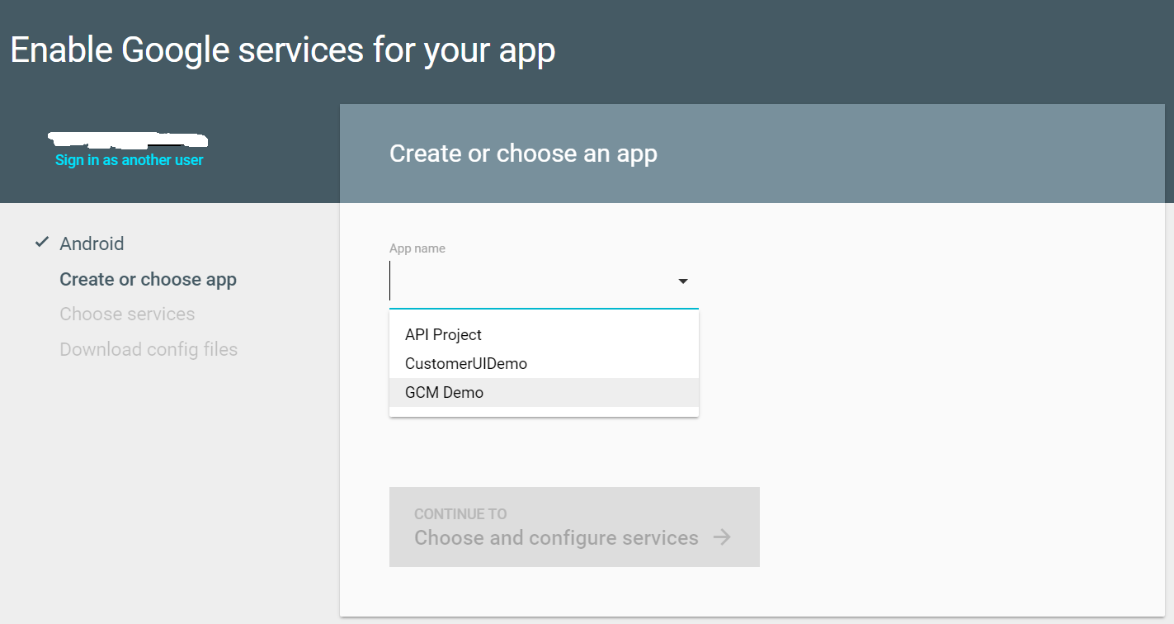
取得 google-services.json (2/6)
選擇專案

Slide 22
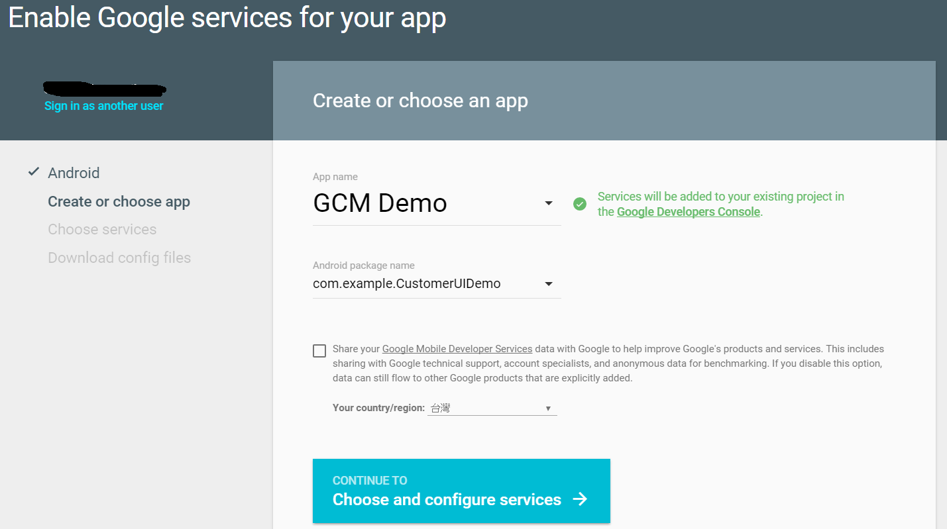
取得 google-services.json (3/6)
選擇/新建 package name

Slide 23
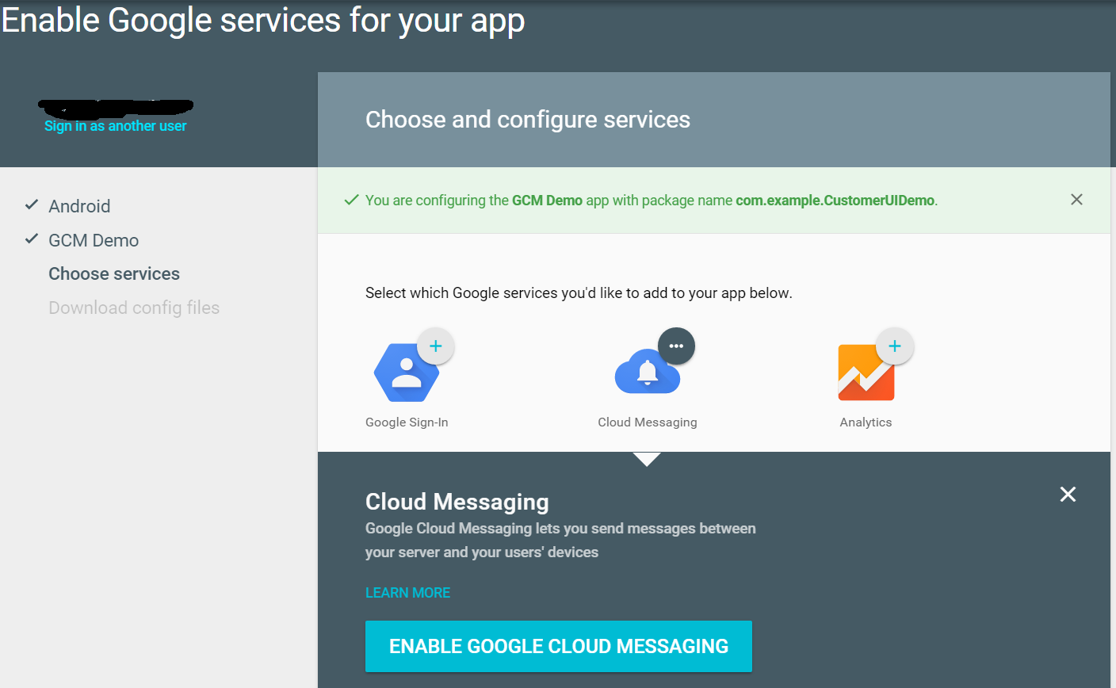
取得 google-services.json (4/6)

Slide 24
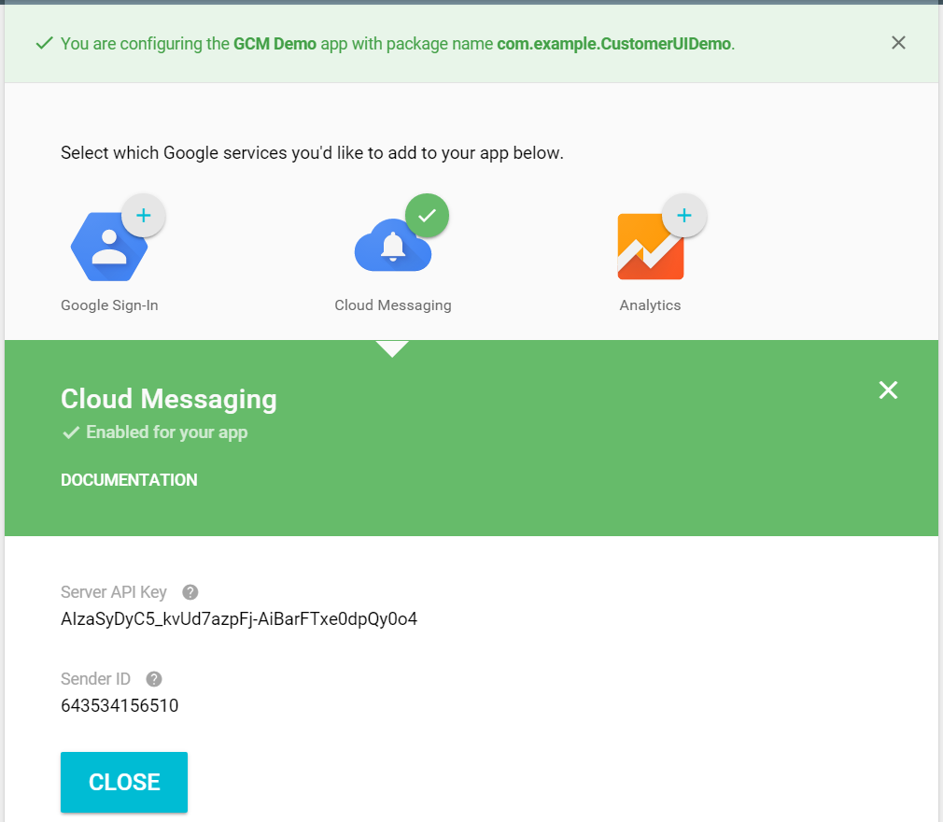
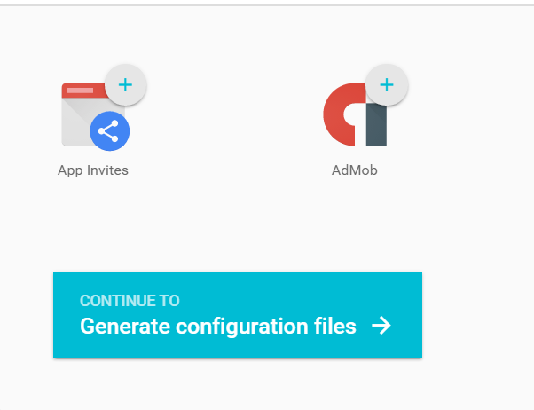
取得 google-services.json (5/6)
按下產生
google-services.json
產生API Key和Sender ID

Slide 25
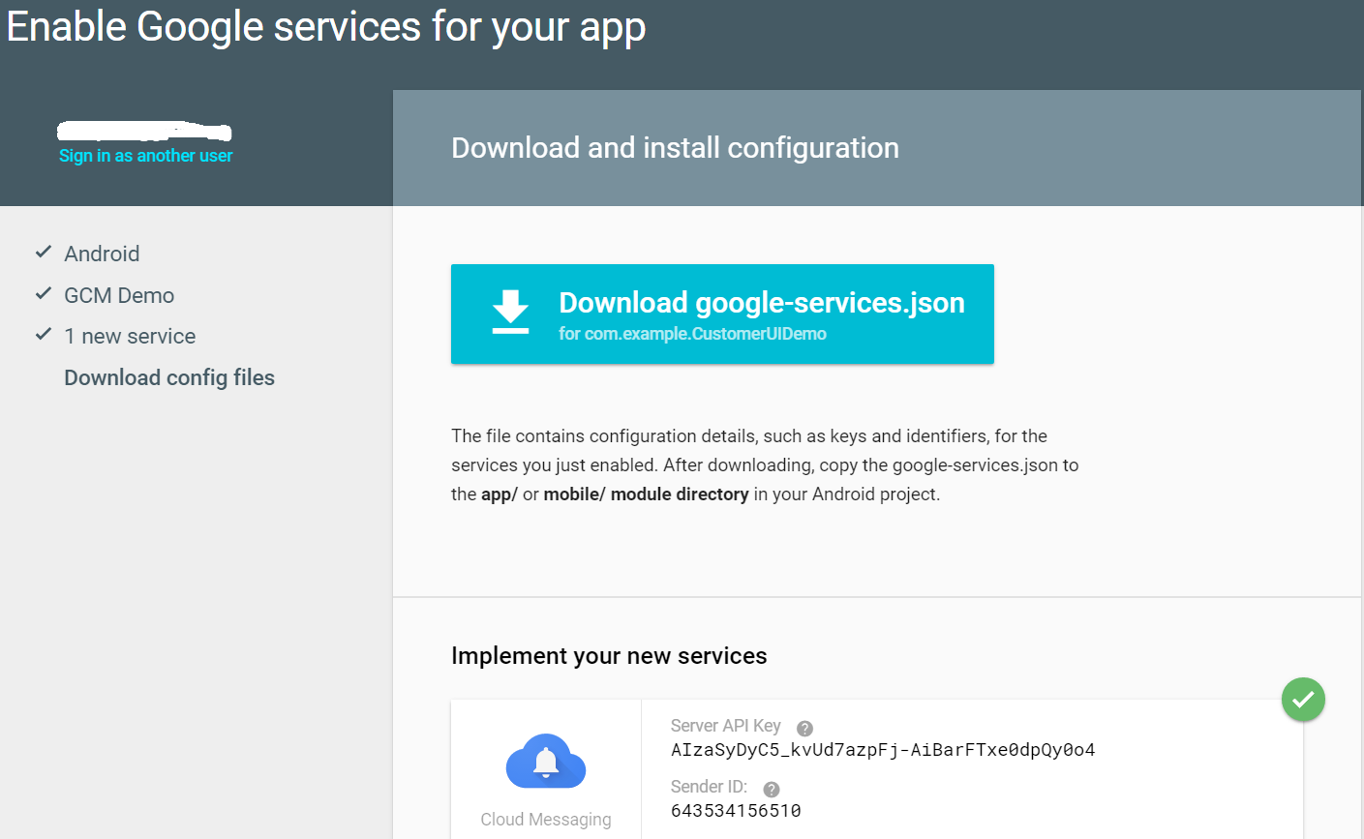
取得 google-services.json (6/6)
下載
google-services.json

Slide 26
設定 AndroidManifest.xml (1/2)
增加 permission
<uses-permission android:name="android.permission.INTERNET" />
<uses-permission android:name="android.permission.WAKE_LOCK" />
<uses-permission android:name="com.google.android.c2dm.permission.RECEIVE" />
<permission android:name="com.example.CustomerUIDemo.permission.C2D_MESSAGE"
android:protectionLevel="signature" />
<uses-permission android:name="com.example.CustomerUIDemo.permission.C2D_MESSAGE" />
區域1
com.example.CustomerUIDemo 是 application package name
區域1: 避免其他App會收到GCM要發這個app的訊息。

Slide 27
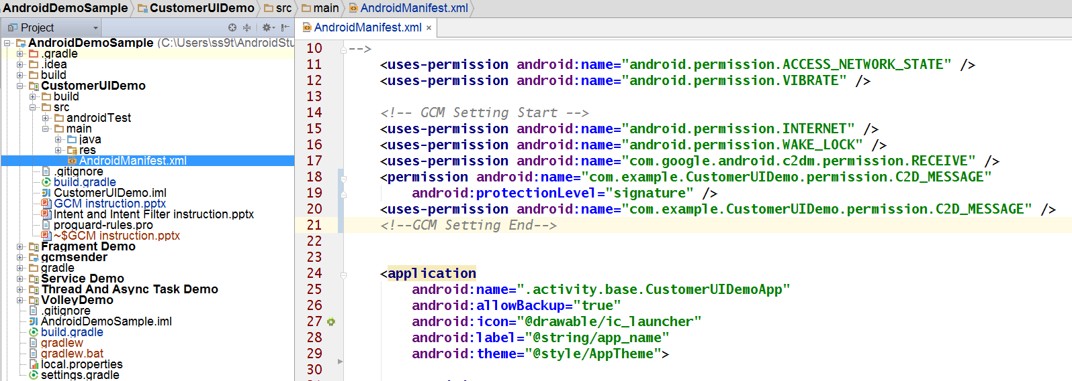
設定 AndroidManifest.xml (2/2)

Slide 28
App Server sends Messaging
GCM
App Server
Post the Message to GCM
Register to GCM
Get a message from GCM
Save registered ID
to App Server
Get registered ID
App Client

Slide 29
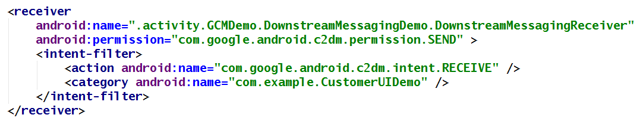
Downstream Messaging (1/7)
增加Receiver，設定AndroidManifest.xml
<receiver
android:name=".activity.GCMDemo.DownstreamMessagingDemo.DownstreamMessagingReceiver"
android:permission="com.google.android.c2dm.permission.SEND" >
<intent-filter>
<action android:name="com.google.android.c2dm.intent.RECEIVE" />
<category android:name="com.example.CustomerUIDemo" />
</intent-filter>
</receiver>
Package Name

Slide 30
Downstream Messaging (2/7)
Server 向 GCM 發訊息 (1/4)
URL: https://android.googleapis.com/gcm/send
Header 設定
Authorization: API Key (API 金鑰)
Content-Type: application/json

Slide 31
Downstream Messaging (3/7)
Server 向 GCM 發訊息 (2/4)
post 資料，JSON格式(1): 傳送單一user
{ "to" : " user註冊的register ID“, "data": {傳送訊息內容 } }
Ex:
{ "to" : "bk3RNwTe3H0:CI2k_HHwgIpoDKCIZvvDMExUdFQ3P1...“, "data": { "score": "5x1", "time": "15:10" } }

Slide 32
Downstream Messaging (4/7)
Server 向 GCM 發訊息 (3/4)
post 資料，JSON格式(2): 傳送多個user
{“registration_ids":[“user註冊的register ID"],
"data":{傳送訊息內容} }
Ex:
{"registration_ids":["APA91bH2vsurFMpH2dQDYPIW8x"],
"data":{
"message":{"model":"AAA-001",
"name":"Car",
"color":"Red" }
}
}
registration_ids 可以設定多筆，就可以傳給多個user
data 內容可以自行定義，只要是JSON格式及可
client 收到及為”傳送訊息內容”

Slide 33
Downstream Messaging (5/7)
Server 向 GCM 發訊息 (4/4)
Server Response 的訊息如下
{"multicast_id":6934727490657173521,
"success":1,
"failure":0,
"canonical_ids":0,
"results":[{"message_id":"0:1448011210423470%5d3f2c26f9fd7ecd"}]}
success: 推播成功的裝置數量
failure: 推播失敗的裝置數量

Slide 34
Downstream Messaging (6/7)
Client 收到JSON格式
{from=518863485658,
message={
"color":"Red",
"name":"Car",
"model":"AAA-001"},
collapse_key=do_not_collapse}

Slide 35
Downstream Messaging (7/7)
HTTP connection Server Reference
https://developers.google.com/cloud-messaging/http-server-ref#send-downstream

Slide 36
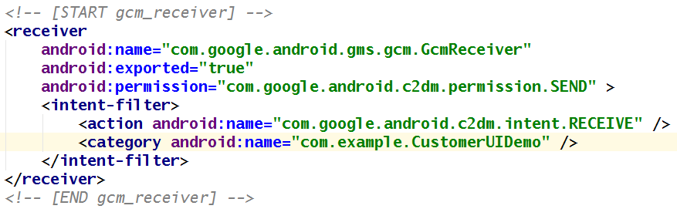
Topics Messaging (1/7)
設定AndroidManifest.xml (1/3)
增加 GCM Receiver
<receiver
android:name="com.google.android.gms.gcm.GcmReceiver"
android:exported="true"
android:permission="com.google.android.c2dm.permission.SEND" >
<intent-filter>
<action android:name="com.google.android.c2dm.intent.RECEIVE" />
<category android:name="com.example.CustomerUIDemo" />
</intent-filter>
</receiver>
com.example.CustomerUIDemo 是 application package name

Slide 37
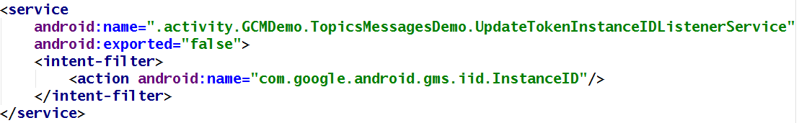
Topics Messaging (2/7)
設定AndroidManifest.xml (2/3)
增加 InstanceIDListenerService (為了避免token重復使用，所以會每隔一段時間就更新token)。
<service
android:name=".activity.GCMDemo.TopicsMessagesDemo.UpdateTokenInstanceIDListenerService"
android:exported="false">
<intent-filter>
<action android:name="com.google.android.gms.iid.InstanceID"/>
</intent-filter>
</service>

Slide 38
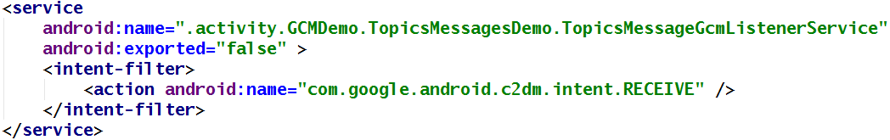
Topics Messaging (3/7)
設定AndroidManifest.xml (3/3)
增加GcmListenerService
<service
android:name=".activity.GCMDemo.TopicsMessagesDemo.TopicsMessageGcmListenerService"
android:exported="false" >
<intent-filter>
<action android:name="com.google.android.c2dm.intent.RECEIVE" />
</intent-filter>
</service>

Slide 39
Topics Messaging (4/7)
Server 向 GCM 發訊息 (1/3)
URL: https://android.googleapis.com/gcm/send
Header 設定
Authorization: API Key (API 金鑰)
Content-Type: application/json

Slide 40
Topics Messaging (5/7)
Server 向 GCM 發訊息 (2/3)
post 資料，JSON格式
{ "to" : "Topics“, "data": {傳送訊息內容 } }
Ex:
{"to":"/topics/global",
"data":{
"message":{
"model":"AAA-001",
"name":"Car",
"color":"Red"}
}
}

Slide 41
Topics Messaging (6/7)
Server 向 GCM 發訊息 (3/3)
Server Response 的訊息如下
{"message_id":5772594877678148354}

Slide 42
Topics Messaging (7/7)
Client 收到JSON格式
{ from=/topics/global,
message={
"color":"Red",
"name":"Car",
"model":"AAA-001"},
collapse_key=do_not_collapse}

Slide 43
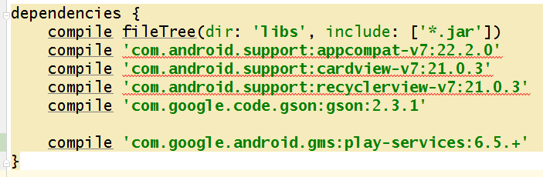
備註 1
最早在Application 中build.gradle的設定
只要增加dependencies
compile 'com.google.android.gms:play-services:6.5.+'

Slide 44
備註 1
設定AndroidManifest.xml (2/3)
增加meta-data
<meta-data android:name="com.google.android.gms.version" android:value="@integer/google_play_services_version" />
設定完成後，要Rebuild project，這樣meta-data才會產生

